Slide 1

Week 6
Course Review & Advanced Topics
Functions
Instructor: Asst. Prof. LIN Shang-Wei
Email: shang-wei.lin@ntu.edu.sg

Slide 2

Abstraction in Different Aspects
Abstraction in Data: Data Structures
Programs = Algorithms + Data Structures
(1976, Niklaus Wirth)
Abstraction in Algorithms:
Functions

Slide 3
Function Basics

Slide 4
Function Definition in Python
Function name must follow variable naming rules.
List of parameters being passed: in parentheses, comma-separated.
def
functionName
(parameter1, parameter2)
:
statement1
statement2
return valueToReturn
Function suite:
contains code to perform some action
indented
Keyword indicating function is defined.
Suite of the function follows the colon.
tab
Return statement: indicates the value returned when the function finishes.

Slide 5
Dynamics of Function Calls
Main Program
statement
fahrenheit = cel2fahr(25)
statement
statement
25
Function
call
def cel2fahr(celsius):
val = celsius * 1.8 + 32
return val
return
77

Slide 6

Q1: What is the output of the following Python program?
charList = ['a', 'e', 'i', 'o', 'u']
myStr = "This is a string!"
def funcA(content, target):
num = 0
for char in content:
if char in target:
num += 1
return num
result = funcA(myStr, charList)
print(result)
0
1
2
3
4
5
✔

Slide 7
Q2: What is the output of the following Python program?
myStr = "Hello"
result = 0
def funcA(content):
num = 0
for char in content:
num += 1
return num
funcA(myStr)
print(result)
✔
0
1
2
3
4
5
result = funcA(myStr)
5

Slide 8
Advanced Topics
Scope and Namespace

Slide 9
Scope
“The set of program statements over which a variable exists, i.e. can be referred to.”
It is about understanding, for any variable, what its associated value is.
A function has its own scope: its function suite (body)
def myFunc(param1, param2):
statement1
statement2
…

Slide 10
Namespace
Namespace is an association of name and objects
It looks like a dictionary, and for the most part it is (at least for modules and classes).
Names
Objects
var1
23
a
1,345
myString
“blah”

Slide 11
Scope vs. Namespace
The same thing, but from different point views
Physical point of view
vs.
Logical point of view
Names
Objects
def myFunc(param1, param2):
var1 = 23
a = 1.345
myString = ‘blah’
var1
23
vs.
a
1,345
myString
“blah”

Slide 12

LEGB Rule
For Python, there are potentially multiple namespaces that could be used to determine the object associated with a variable name.
Which one to use?
The search order of namespaces for a name:
Local : inside the function in which it was defined.
Enclosing : If not there, enclosing/encompassing. Is it defined in an enclosing function?
Global : If not there, is it defined in the global namespace?
Built-in : Finally, check the built-in, defined as part of the special built-ins scope.
Else, ERROR.

Slide 13
LEGB Rule (cont.)
search order:
Global
Local
Enclosing
Enclosing
Build-in
Local
import
Global
Build-in
ERROR

Slide 14
Local and Global
If a reference is assigned in a function, then that reference is only available within that function.
If a reference with the same name is provided outside the function, the reference is reassigned
myVar = 123 # global
def myFunc():
myVar = 500 # local
yourVar = -10 # local
print(myVar, yourVar)
myFunc() # prints 500 -10
print(myVar) # prints 123
print(yourVar) # ERROR
Global Namespace
Objects
myVar
123
myFunc Namespace
myVar
500
yourVar
-10

Slide 15
Enclosing
def enclosing():
myVariable = 'defined by enclosing'
def enclosed():
print('scope: ' + myVariable)
enclosed()
enclosing()
scope: defined by enclosing # output

Slide 16
The Global Keyword
What if you really want to use or modify the global variables inside a function?
Ans: Using the global keyword in a function allows you to access global objects.
myVar = 100
def myFn():
global myVar
myVar = -1
myFn()
print(myVar) # prints -1
Global Namespace
Objects
-1
myVar
100
myFn Namespace
myVar

Slide 17
Functions and Scope

Slide 18
Function’s Scope
Each function maintains a namespace for names defined locally within the function.
“Locally” means one of two things:
a name assigned something within the function
an argument received by invocation of the function

Slide 19
Parameters vs. Arguments
For each argument in the function invocation, the argument’s associated object is passed to the corresponding parameter in the function.
The argument and the parameter share an association with the same object.

Slide 20
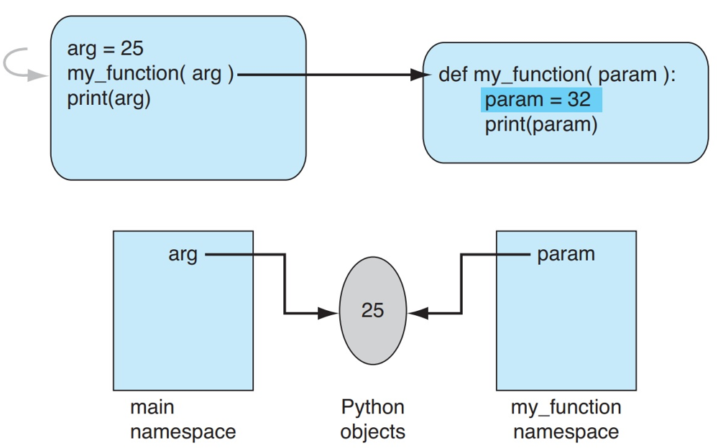
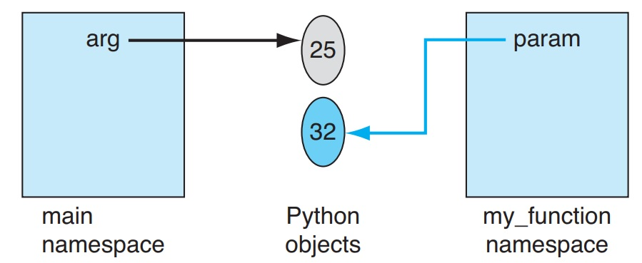
Parameters vs. Arguments (cont.)
If a parameter is assigned to a new value, then a new association is created.
This assignment does not affect the object associated with the argument.

Slide 21
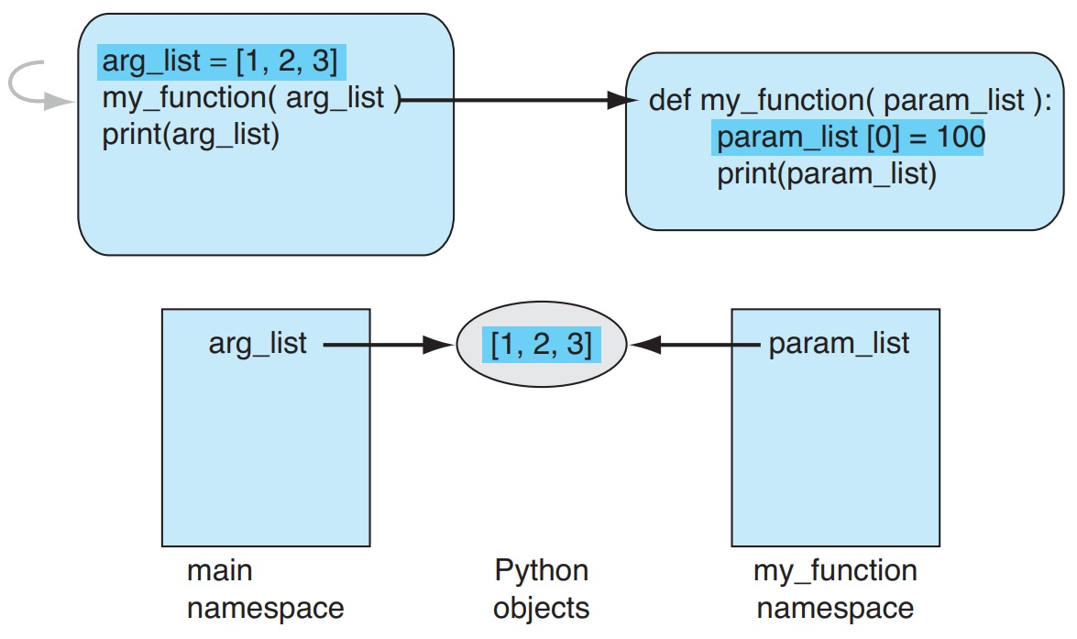
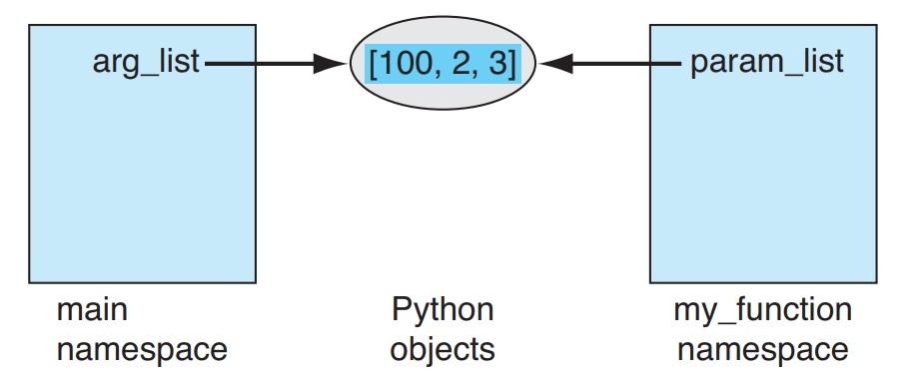
Parameters vs. Arguments (cont.)
When passing a mutable data structure, if the shared object is modified, both the parameter and the argument will reflect that change.

Slide 22
Q3: Are the results of the two program the same?
def myFun (param):
param.append(4)
return param
myList = [1,2,3]
newList = myFun(myList)
print(myList,newList)
def myFun (param):
param=[1,2,3]
param.append(4)
return param
myList = [1,2,3]
newList = myFun(myList)
print(myList,newList)
Program A
Program B
Yes
No
✔

Slide 23
Program A
Main Namespace
Objects
def myFun (param):
param.append(4)
return param
myList = [1,2,3]
newList = myFun(myList)
print(myList,newList)
myList
newList
1
2
3
4
myFun Namespace
param
Program A
[1,2,3,4] [1,2,3,4] # output

Slide 24
Program B
Main Namespace
Objects
def myFun (param):
param=[1,2,3]
param.append(4)
return param
myList = [1,2,3]
newList = myFun(myList)
print(myList,newList)
myList
newList
1
2
3
myFun Namespace
param
1
2
3
4
Program B
[1,2,3] [1,2,3,4] # output

Slide 25
Q4: What is the output of the following Python program?
myVar = 127
def myFun (myVar):
myVar = 7
print(‘myVar: ’, myVar)
myFun(myVar)
print(‘myVar: ’, myVar)
myVar: 7
myVar: 7
myVar: 127
myVar: 127
myVar: 7
myVar: 127
myVar: 127
myVar: 7
✔

Slide 26
Q5: What is the output of the following Python program?
myVar = 127
def myFun ():
a = myVar + 1
print(‘a: ’, a)
myFun()
✔
a: 128
a: 127
ERROR

Slide 27
Q6: What is the output of the following Python program?
myVar = 127
def myFun ():
myVar = myVar + 1
myFun()
print(myVar)
myVar = 127
def myFun ():
global myVar
myVar = myVar + 1
myFun()
print(myVar)
How to fix it?
local variable ‘myVar’ referenced before assignment
128
127
ERROR
Objects
Main Namespace
myVar
127
✔
myFun Namespace
myVar
??

